Slide 1
Function Overloading
Default Arguments
Inline Functions

Slide 2
Function Overloading
Function overloading allows for multiple functions with the same name, but have different types and/or numbers of parameters.
Examples:
  float average (int a, int b);
  float average (float a, float b);
  char average (char first, char second);
  float average (float a, float b, float c);

Slide 3
Function Overloading
Example:
int max(int a, int b) {
  if (a>= b)
  return a;
  else
  return b;
}
float max(float a, float b) {
  if (a>= b)
  return a;
  else
  return b;
}

Slide 4
Default Arguments
A default argument is a value given in the function declaration that the compiler automatically inserts if the caller does not provide a value for that argument in the function call.
Syntax:
return_type f(…, type x = default_value,…);

Slide 5
Default Arguments
(Examples)
The default value of the 2nd argument is 2.
This means that if the programmer calls pow(x), the compiler will replace that call with pow(x,2), returning x²
double pow(double x, int n=2)
// computes and returns x^{n}

Slide 6
Default Arguments
(Rules)
Once an argument has a default value, all the arguments after it must have default values.
Once an argument is defaulted in a function call, all the remaining arguments must be defaulted.
int f(int x, int y=0, int n)
// illegal
int f(int x, int y=0, int n=1)
// legal

Slide 7
Examples of Legal/Illegal Defaulting in Function Calls
Let substring be a function whose prototype is:
Assume
Which call to substring is OK and which is not OK? If OK, what is it equivalent to?
  substring(p)
  substring(p,15)
  substring( )
void substring (string p, int length=10, int pos=0)
string p=“hello”;

Slide 8
Default Arguments and
Function Overloading
Default arguments and function overloading can give rise to an ambiguity
Consider an overloaded function f where one declaration has default arguments that, if removed, makes the function look identical to a second declaration, as in
1. int f(int x, int y=0); returns x^{y}
2. int f(int x); // returns 2^{x}
If we call f(2), is it to f
in (1) or (2)?
The 1st returns 1.
The 2nd returns 4.

Slide 9
Default Arguments and
Function Overloading (Contd.)
If overloaded declarations of a function with default arguments cause ambiguity, the compiler gives an error message.
It is the responsibility of the programmer not to cause such ambiguities.

Slide 10
Inline Function
C++ provides inline functions to reduce the function call overhead.
An inline function is a function that is expanded in line when it is called.
When the inline function is called whole code of the inline function gets inserted or substituted at the point of the inline function call.
This substitution is performed by the C++ compiler at compile time.
An inline function may increase efficiency if it is small.

Slide 11
Inline Function (Contd.)
Syntax:
      inline return-type function-name (parameters)
      {
      // Function code
      }

Slide 12
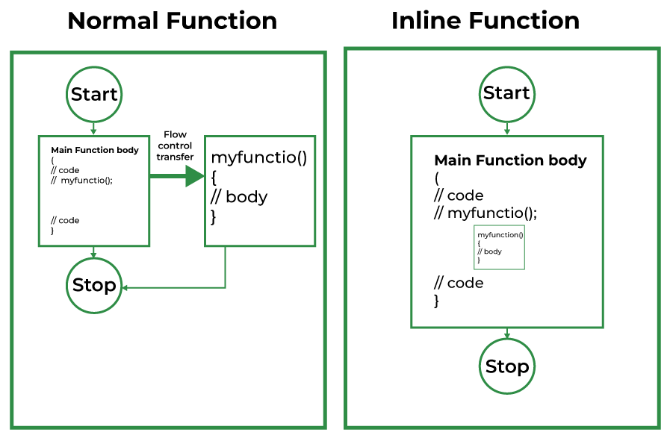
Inline Function (Contd.)

Slide 13
Inline Function (Contd.)
Remember, inlining is only a request to the compiler, not a command.
The compiler can ignore the request for inlining.
The compiler may not perform inlining in such circumstances as:
  If a function contains a loop. (for, while and do-while)
  If a function contains static variables.
  If a function is recursive.
  If a function return type is other than void, and the return statement doesn’t exist in a function body.
  If a function contains a switch or goto statement.

Slide 14
Inline Function (Contd.)
#include <iostream>
using namespace std;
inline int cube(int s) {
return s * s * s;
}
int main()
{
cout << "The cube of 3 is: " << cube(3) ;
return 0;
}

Slide 15
Inline Function (Contd.)
int sum(int a, int b)
{
return a + b;
}
int main()
{
int r = sum(5,6);
cout<<r;
}

Slide 16
Inline Function (Contd.)
If you declare your function as inline:
inline int sum(int a, int b) {
return a + b;
}
The compiler will replace the actual function call to the actual body of your function, thus, the resulting binary will have something like:
int main() {
int r = 5 + 6;
cout<<r;
}

